Slide 1
Binary Search Tree
Materials are adapted from “Data Structures: A Pseudocode Approach with C,” 2nd ed., by Richard F. Gilberg & Behrouz A. Forouzan

Slide 2
Basic Concepts
Linear list structure
array vs. linked list
search algorithm
insertion and deletion algorithm
Binary search trees
provide an excellent structure for searching a list and at the same time for inserting and deleting data into the list
A binary search tree (BST) is a binary tree with following properties:
All items in the left subtree are less than the root.
All items in the right subtree are greater than or equal to the root.
Each subtree is itself a binary search tree

Slide 3
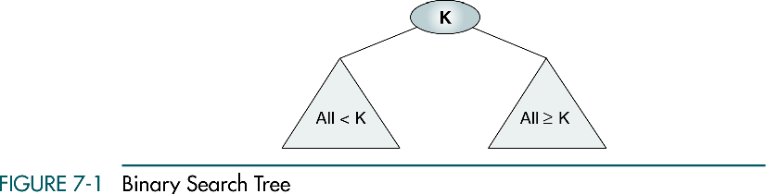

Slide 4
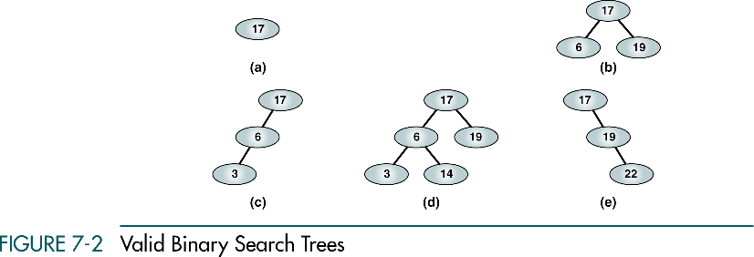
(a), (b) - complete and balanced trees;
(d) – nearly complete and balanced tree;
(c), (e) – neither complete nor balanced trees

Slide 5
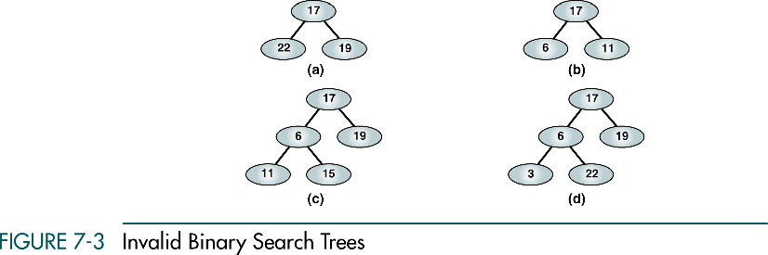

Slide 6
BST Operations
Four basic BST operations
Traversal
Search
Insert
Delete

Slide 7
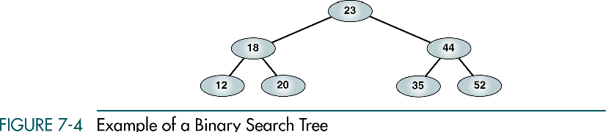
Traversals
Preorder Traversal : 23 18 12 20 44 35 52
Postorder Traversal: 12 20 8 35 52 44 23
Inorder Traversal: 12 18 20 23 35 44 52
→ Inorder traversal produces a sequenced list

Slide 8
Right-Node-Left Traversal
52 44 35 23 20 18 12
Right-node-left traversal of a binary search tree produces a descending sequence

Slide 9
Searches
Find the smallest node
Find the largest node
Find a requested node

Slide 10
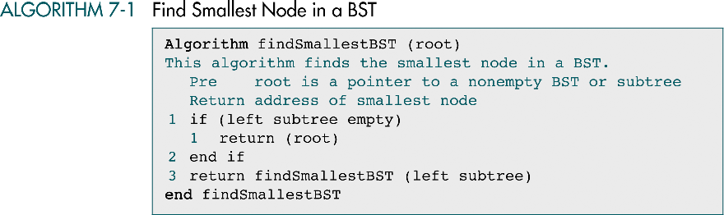
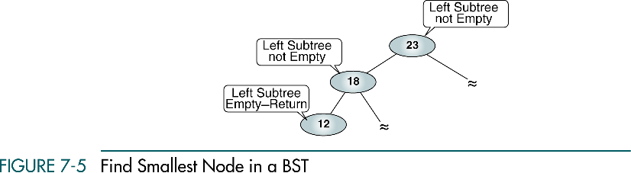

Slide 11
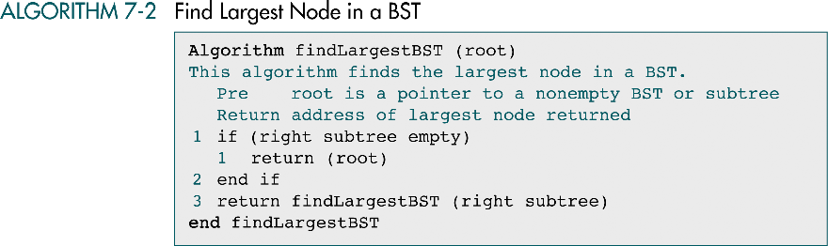

Slide 12
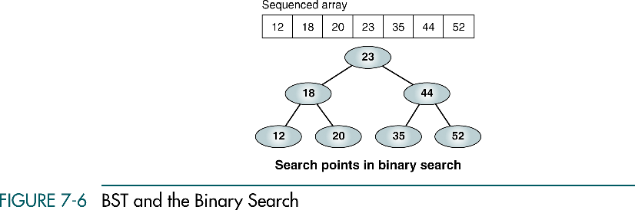
BST Search
Binary tree search
Locates a specific node in the tree
→ binary search

Slide 13
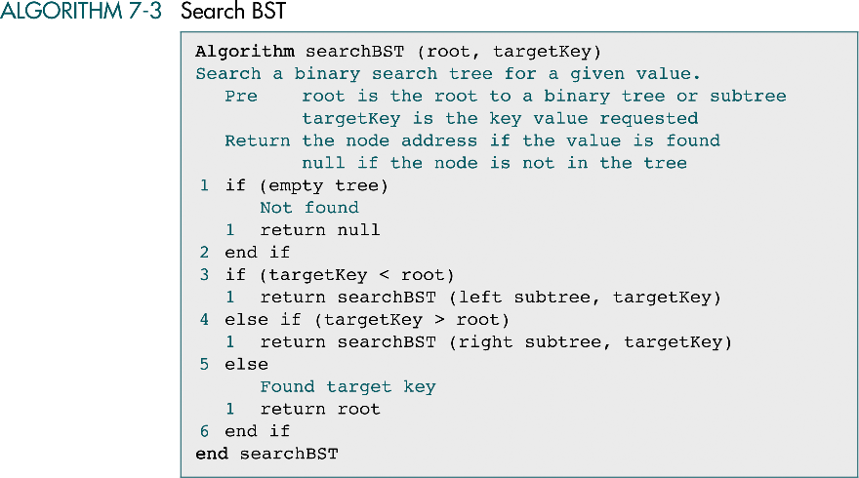

Slide 14
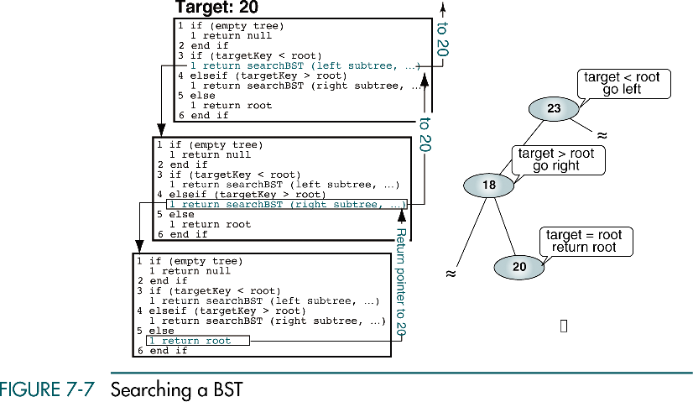

Slide 15
Insertion
To insert data all we need to do is follow the branches to an empty subtree and then insert the new node.
In other words, all inserts take place at a leaf or at a leaflike node – a node that has only one null subtree

Slide 16
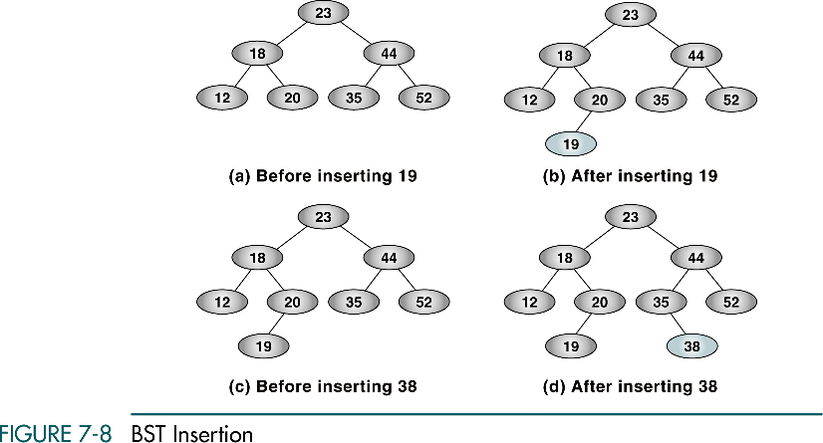
Inserting 23?

Slide 17
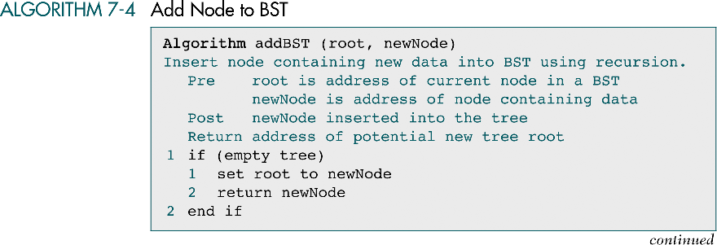
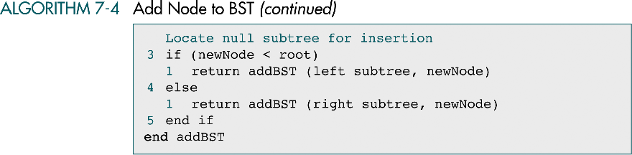

Slide 18
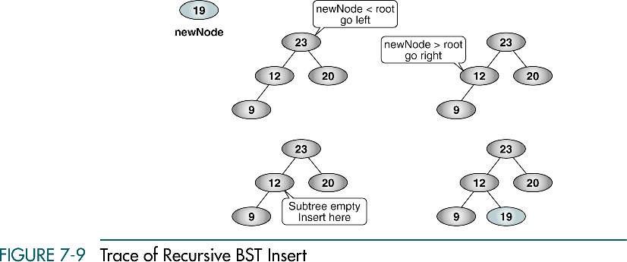

Slide 19
Deletion
There are four possible cases when we delete a node:
The node to be deleted has no children
In this case, all we need to do is delete the node.
The node to be deleted has only a right subtree.
We delete the node and attach the right subtree to the deleted node’s parent.
The node to be deleted has only a left subtree
We delete the node and attach the left subtree to the deleted node’s parent.
The node to be deleted has two subtrees
It is possible to delete a node from the middle of a tree, but the result tends to create very unbalanced trees.

Slide 20
Deletion
Rather than simply delete the node, we try to maintain the existing structure as much as possible by finding data to take the place of the deleted data. This can be done in one of two ways:
We can find the largest node in the deleted node’s left subtree and move its data to replace the deleted node’s data.
We can find the smallest node on the deleted node’s right subtree and move its data to replace the deleted node’s data.

Slide 21
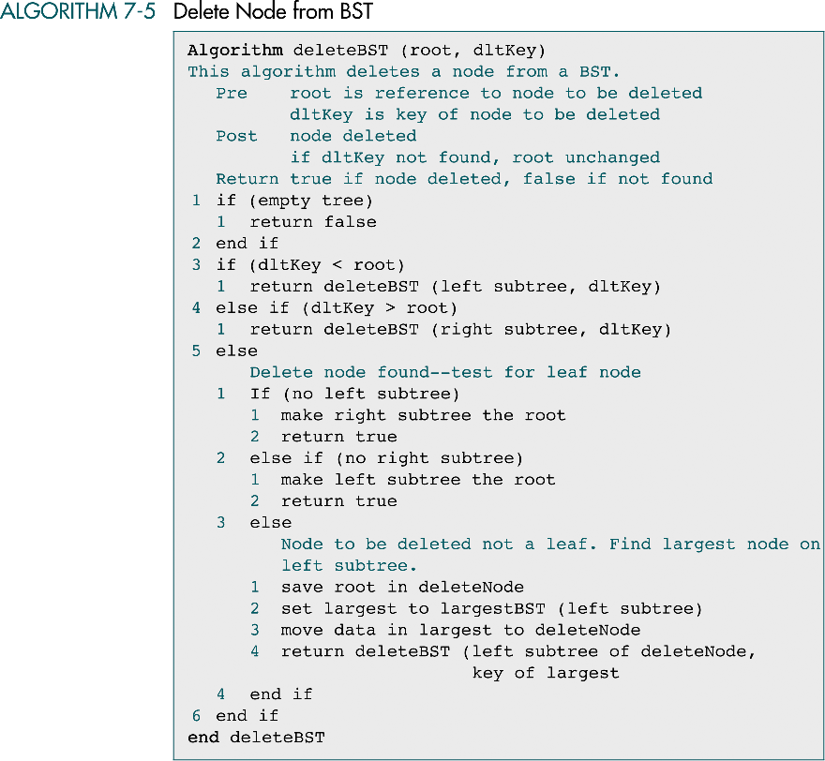

Slide 23
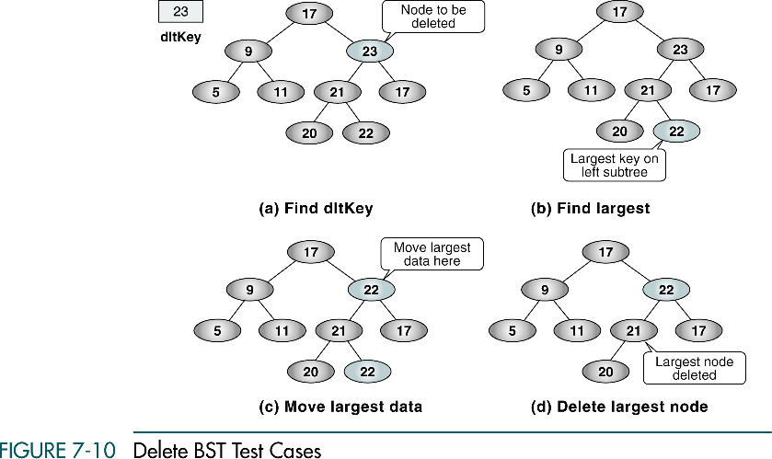

Slide 24
Threaded Trees
Binary tree traversal algorithms are written using either recursion or programmer-written stacks
If the tree must be traversed frequently, using stacks rather than recursion may be more efficient
A third alternative is a threaded tree
In a threaded tree, null pointers are replaced with pointers to their successor nodes

Slide 25
Threaded Trees
To build a threaded tree,
Build a standard binary search tree
Traverse the tree, changing the null right pointers to point to their successors
The traversal for a threaded tree is straightforward
Locate the far-left node
Loop, following the thread (the right pointer) to the next node
No recursion or stack is needed
The traversal is complete when finding a null thread (the right pointer)

Slide 26
